Slide 1
Requirement Analysis Part 2
Software Quality Engineering
CT051-3-3
Software Engineering

Slide 2
Topic & Structure of the lesson
Functional and non-functional requirements
User requirements
System requirements
Interface specification
The software requirements document

Slide 3
Learning Outcomes
By the end of this lecture, YOU should be able to:
  Introduce the concepts of user and system requirements
  Describe functional and non-functional requirements
  Explain how software requirements may be organised in a requirements document

Slide 4
User requirements
Should describe functional and non-functional requirements in such a way that they are understandable by system users who don’t have detailed technical knowledge.
User requirements are defined using natural language, tables and diagrams as these can be understood by all users.

Slide 5
Problems with natural language
Lack of clarity
  Precision is difficult without making the document difficult to read.
Requirements confusion
  Functional and non-functional requirements tend to be mixed-up.
Requirements amalgamation
  Several different requirements may be expressed together.

Slide 6
Guidelines for writing requirements
Invent a standard format and use it for all requirements.
Use language in a consistent way. Use shall for mandatory requirements, should for desirable requirements.
Use text highlighting to identify key parts of the requirement.
Avoid the use of computer jargon.

Slide 7
Requirements and design
In principle, requirements should state what the system should do and the design should describe how it does this.
In practice, requirements and design are inseparable
  A system architecture may be designed to structure the requirements;
  The system may inter-operate with other systems that generate design requirements;
  The use of a specific design may be a domain requirement.

Slide 8
Interface specification
Most systems must operate with other systems and the operating interfaces must be specified as part of the requirements.
Three types of interface may have to be defined
  Procedural interfaces;
  Data structures that are exchanged;
  Data representations.
Formal notations are an effective technique for interface specification.

Slide 9
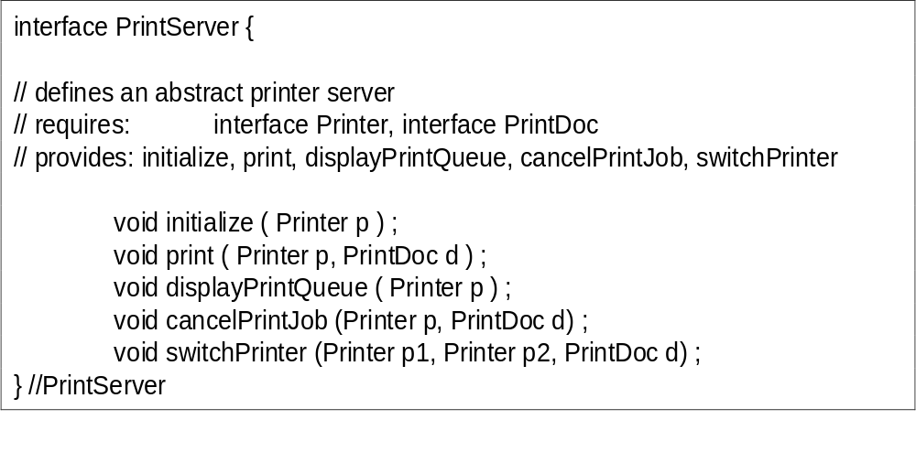
PDL interface description

Slide 10
The requirements document
The requirements document is the official statement of what is required of the system developers.
Should include both a definition of user requirements and a specification of the system requirements.
It is NOT a design document. As far as possible, it should set of WHAT the system should do rather than HOW it should do it

Slide 11
IEEE requirements standard
Defines a generic structure for a requirements document that must be instantiated for each specific system.
  Introduction.
  General description.
  Specific requirements.
  Appendices.
  Index.

Slide 12
Requirements document structure
Preface
Introduction
Glossary
User requirements definition
System architecture
System requirements specification
System models
System evolution
Appendices
Index

Slide 13
Key points
Requirements set out what the system should do and define constraints on its operation and implementation.
Functional requirements set out services the system should provide.
Non-functional requirements constrain the system being developed or the development process.
User requirements are high-level statements of what the system should do. User requirements should be written using natural language, tables and diagrams.

Slide 14
Key points
System requirements are intended to communicate the functions that the system should provide.
A software requirements document is an agreed statement of the system requirements.
The IEEE standard is a useful starting point for defining more detailed specific requirements standards.

